Slide 1
Descriptive Statistics
Statistical Methods for Decision Making

Slide 3
Agenda
Classification of Data
Time Series Data
Cross Sectional Data
Pooled Data
Panel Data
Read Data From Various Sources
Understanding the variables
Numerical Variable
Categorical Variable

Slide 4
Agenda
Descriptive Statistics
Measure of Central Tendency
Distribution of the data
Measure of Dispersion
Skewness and Kurtosis
Covariance and Correlation
Case Study

Slide 5
Exploratory Data Analysis (EDA)
EDA is a process of analyzing the datasets to summarize their main features using numerical and visual methods
In this session, we shall cover the numerical methods to analyze the data
The numerical methods includes descriptive statistics

Slide 6
The Data

Slide 7
What is Data?
Data is units of information in structured or unstructured format.
Examples:
Collection of relevant tweets
Records of yield in a farm over a period of time
Records of stock price every minute
Records of performance of a sports person

Slide 8
Classification of Data
In general, there are four types of data. They are:
Time Series Data
Cross sectional data
Pooled Data
Panel Data

Slide 9
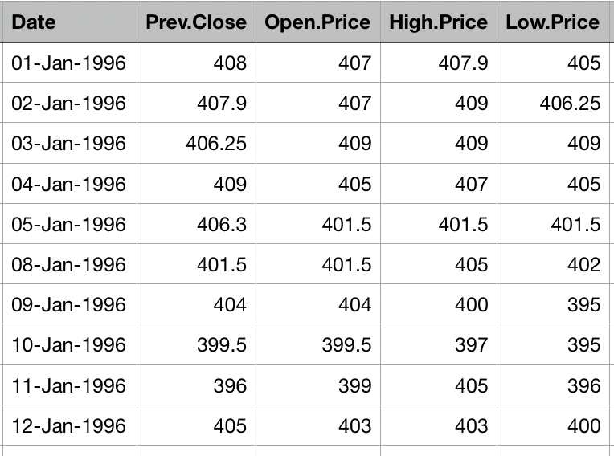
Time series data
Time series data is the set of observations on a variable at different time points
The data may be collected daily, weekly, monthly, or annually
Sample data of daily stock price of a company

Slide 10
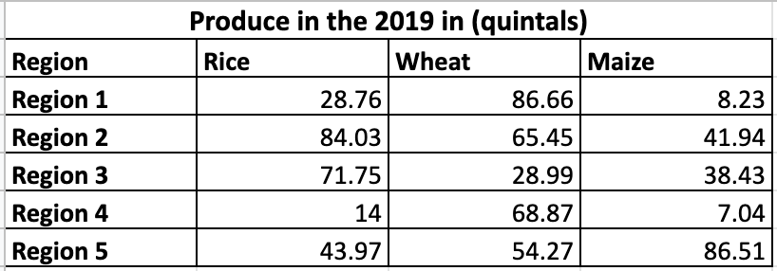
Cross-sectional data
Cross-sectional data are set of observations on two or more variables at the same time point
Sample data of a farm produce in five regions in the year 2019

Slide 11
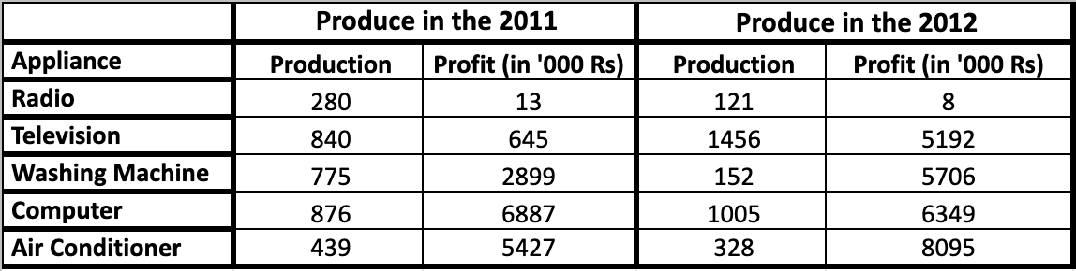
Pooled data
Pooled data is combination of both time series data and cross sectional data.
Sample data of the number of appliances produced in an industry for two years

Slide 12
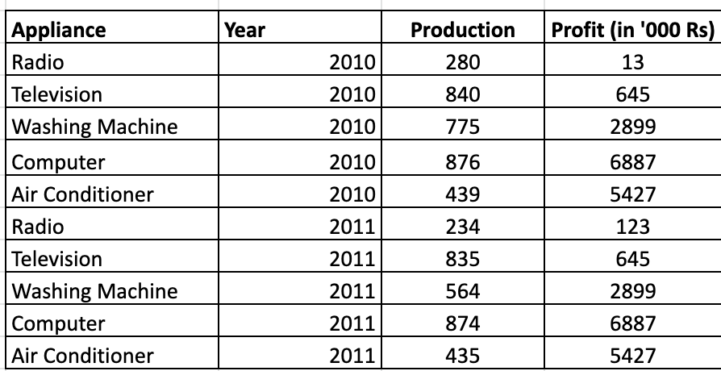
Panel data
Panel data is type of pooled data
The same cross-sectional unit is surveyed over time
Also known as longitudinal or micro-panel data
Sample data of the number of appliances produced and profits earned by a company over a period of two years

Slide 13
Reading Data from Sources

Slide 14
Read the data
Data is available in different sources
In python we can read data from different sources
We shall see how to read data from csv, xlsx, tsv, json, html file formats, zip file and read data from an URL

Slide 15
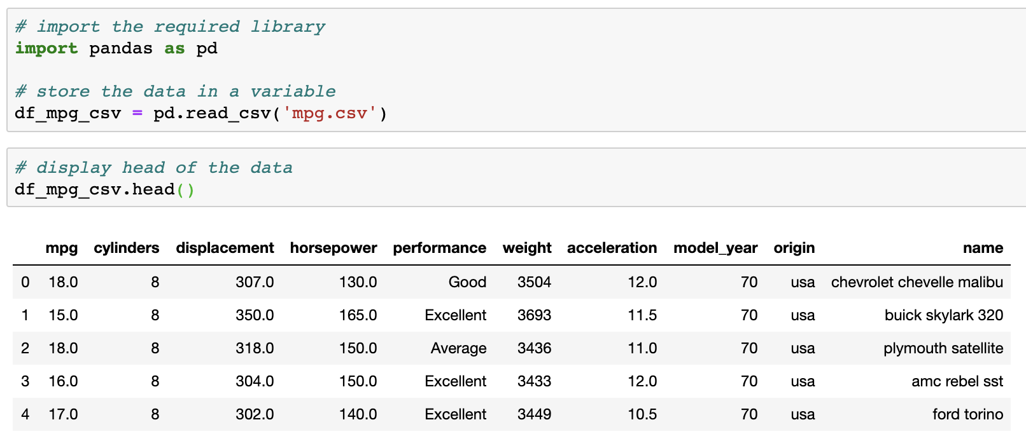
Read a csv file

Slide 16
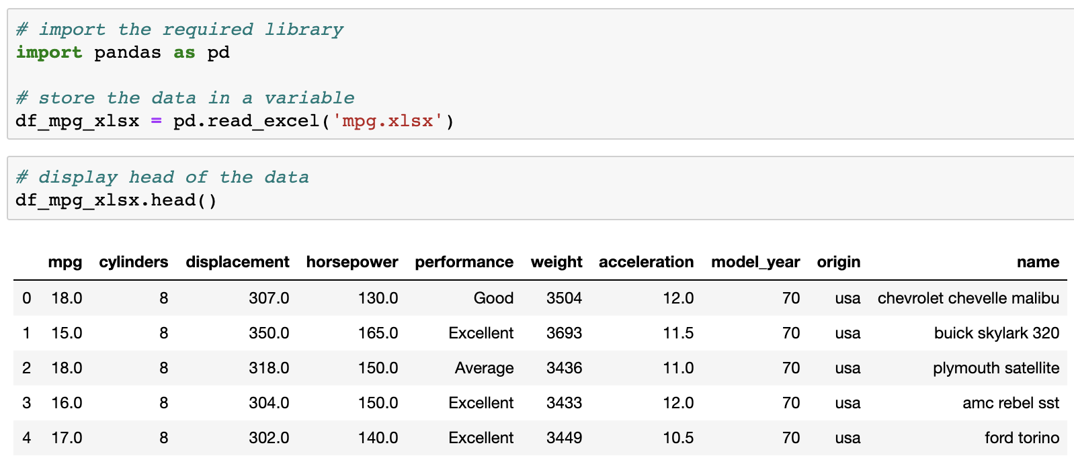
Read an xlsx file

Slide 17
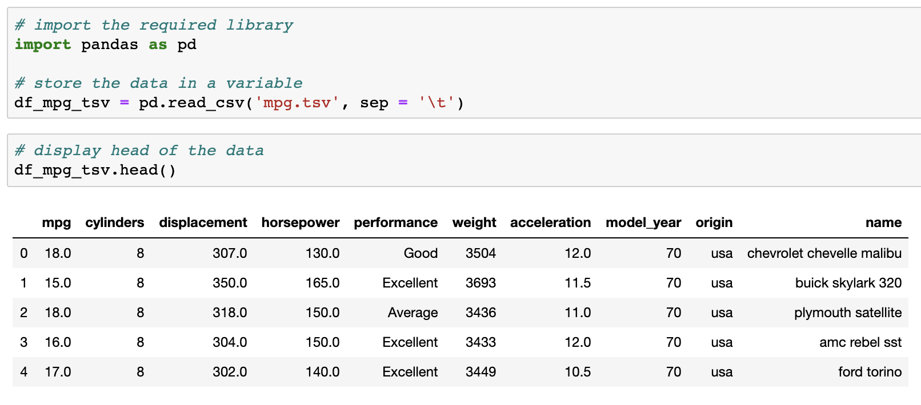
Read a tsv file
sep: delimiter to use
\t : delimiter

Slide 18
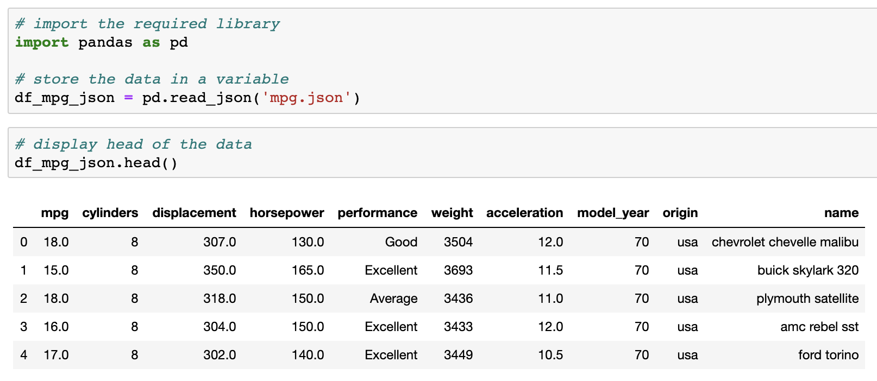
Read a json file

Slide 19
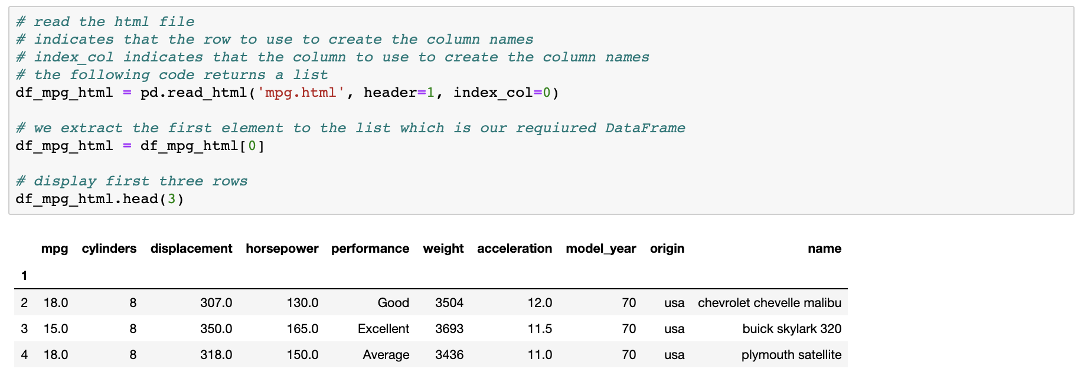
Read a html file

Slide 20
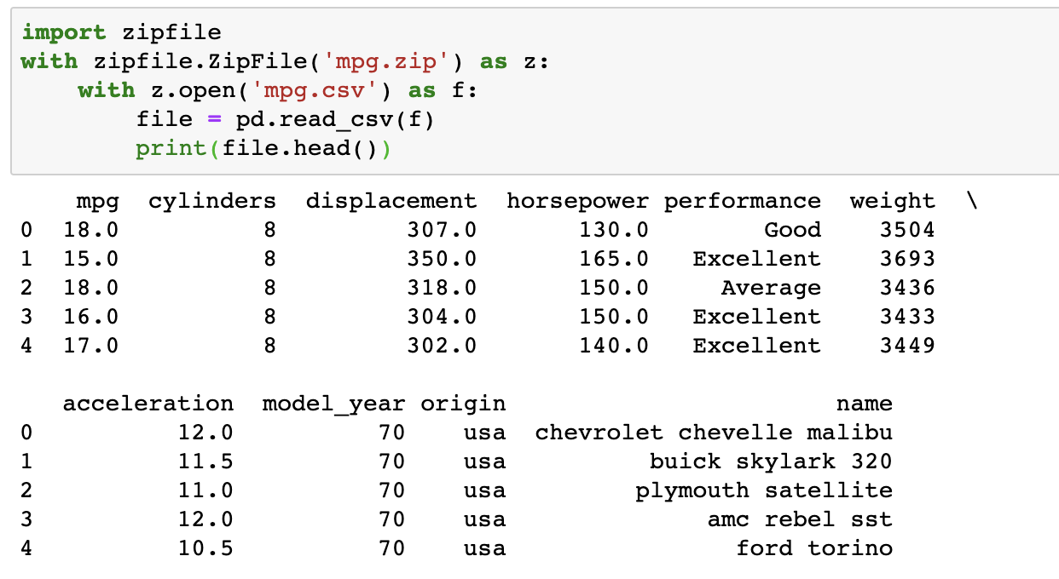
Read a zipped file
Import the required library
Read and open the zip file
Read the csv file

Slide 21
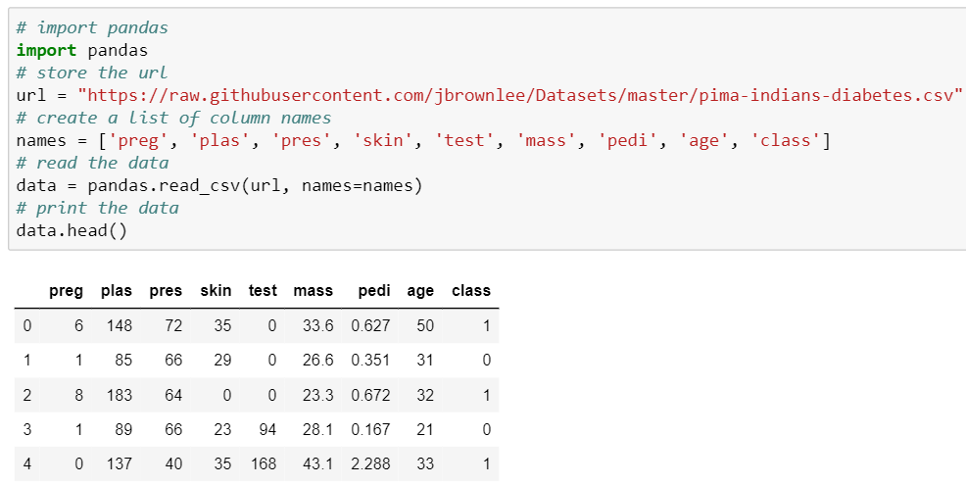
Read data from an url
We use the pima indians diabetes dataset
Store the url. This url contains the csv file of the data
Read the csv

Slide 22
Summary
File Type | Function
CSV File | read_csv(file_address)
TSV File | read_csv(file_address, sep = ‘\t’)
JSON File | read_json(file_address)
HTML File | read_html(file_address)
URL | read_csv(url)

Slide 23
Understanding the variable

Slide 24
Understand the variable
To understand the descriptive statistics, we need to first understand the type of each variable or column
Variable Type
Numeric
Categoric
Discrete
Continuous
Binomial
Nominal
Ordinal

Slide 25
Numerical Variable
A variable which takes a numeric value is called a numeric variable
Also known as quantitative variable
A discrete numeric variable is a random variable which takes discrete values, i.e. values from the set of whole numbers only. It can take countably finite values
Examples:
Number of cars passing by a toll-gate every one minute
Number of defective items in a box

Slide 26
Numerical Variable
A continuous numeric variable is a variable which can have infinite number of values within a range
Examples:
The amount of rainfall in millimeters
Price of a stock

Slide 27
Categorical Variable
Categorical variable has two or more levels
Also known as qualitative variable
Examples:
Colors: red, orange, yellow
Gender: male, female
Economic status: low, medium, high

Slide 28
Categorical Variable
Nominal Data:
Nominal data has no order and has two or more than two categories
It represents discrete units and are used to label variables
Example: Housing type - Apartment, Bungalow, Penthouse
Binary Data:
Binary data has no order and has strictly two categories
Also known as dichotomous variable
Example: Presence or absence of a disease

Slide 29
Categorical Variable
Ordinal Data:
Ordinal data is ordered nominal data
It represents discrete and ordered units
Example: Education - Primary, Secondary, High School, College and University which are ordered

Slide 30
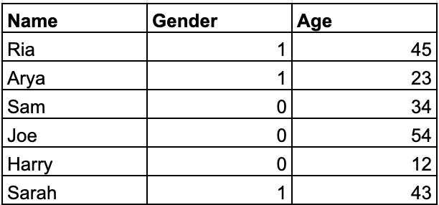
At times data may appear to be numeric but is actually categorical
Consider the adjoining table. The ‘Gender’ column has value 1 and 0
The numeric values used to represent a categorical variable cannot be used for numerical computation

Slide 31
Data Analysis
Data Analysis
Descriptive Analysis
Inferential Analysis
It is used to only describe the sample or summarize information about the sample
Also known as Descriptive Statistics
It is used to make inferences and generalizations about the broader population
Also know an Inferential Statistics

Slide 32
Descriptive Statistics

Slide 33
What is descriptive statistics?
Descriptive statistics is the term given to the analysis of the data that helps describe, visualize or summarize the data
Helps exhibit the patterns in the data
However, descriptive statistics only help in understanding the data and not make conclusions regarding any hypothesis
We can not generalise the facts, they are confined only to the data at hand (that may be the sample)

Slide 34

Population & Sample
Population is a collection of all the individuals or objects
Sample is a subset of the population which is a representative of the population
Sample
Population
Example:
Suppose a company producing electric bulbs wants to know the average life of a bulb. If the details on average life of all bulbs are available, then this information is regarded as the population.
It would be challenging for the company to test each and every bulb produced. In such a scenario, the company would draw a sample from the produced bulbs to test.

Slide 35
Descriptive statistics
The major characteristics we observe in each variable of the data set are:
Measures of central tendency
Distribution of the data
Measures of dispersion
The above characteristics help us in understanding the data and are part of the exploratory data analysis

Slide 36
Measures of Central Tendency

Slide 37
Measures of central tendency
A measure of central tendency is a single value that identifies the central position of the data
It includes mean, median, mode and partition values

Slide 38
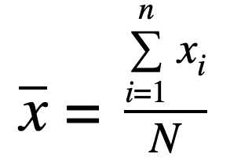
Mean
Mean is a central tendency of the data
It is defined as the sum of all observations divided by the number of observations:
where N is the total number of observations
The whole data is spread out around the mean

Slide 39
Mean
Merits:
Based on all observation
Demerits:
Affected by extreme observations (outliers)
Arithmetically it is not possible to obtain the mean of a data with missing values
Mean can not be calculated for categorical data

Slide 40
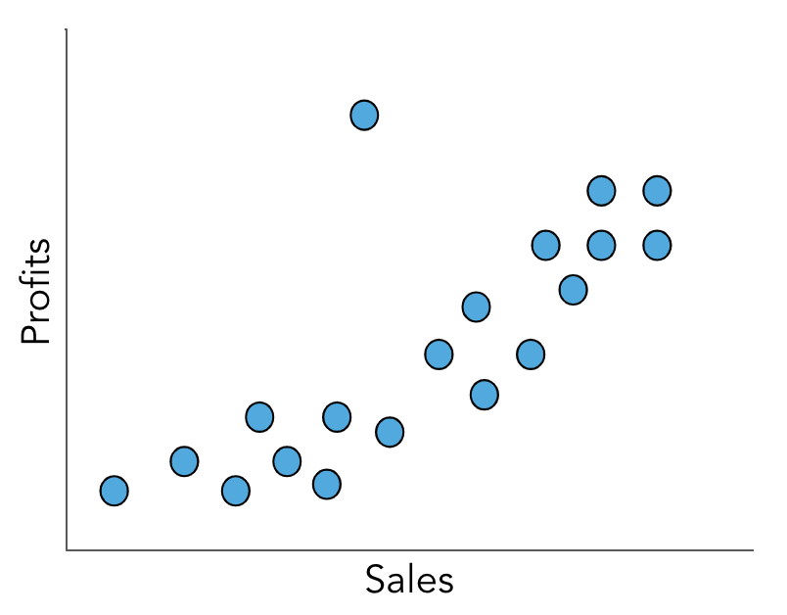
Outlier
An outlier is a value that behaves differently than other observations
It does not not follow the usual pattern
Outlier

Slide 41
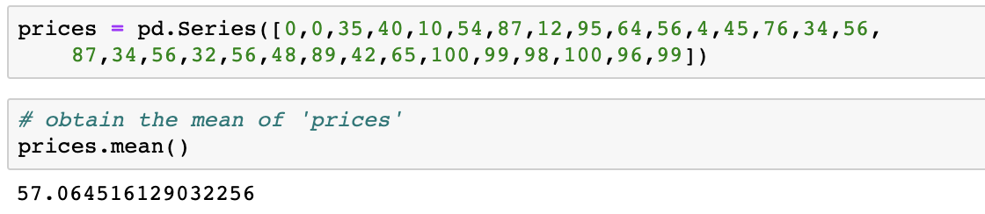
Obtain the mean
Each column of a DataFrame is a pandas Series.
Let us create a series and find its mean.

Slide 42
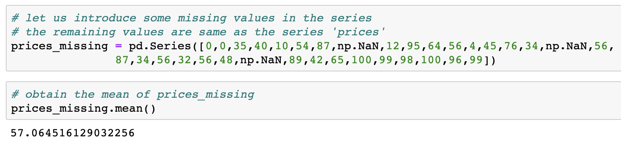
Obtain the mean
Arithmetically, it is not possible to compute mean of missing data. But, python ignores the missing values and calculates the mean of the available data in the series
Introduce missing values in the previous series

Slide 43
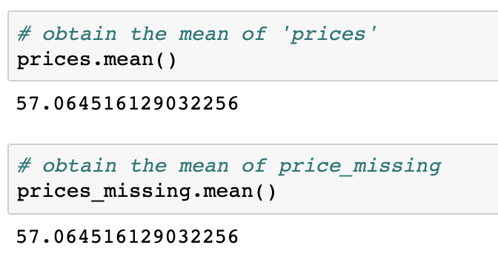
Mean of series with missing values
We notice that the means obtained are the same
This is because the function drops the missing values before calculating the mean value

Slide 44
Trimmed mean
Arithmetic mean obtained by ignoring lowest and highest α% observations is called as the α% - trimmed mean
Using a trimmed mean, it is possible to eliminate the influence of outliers
Note the observations are arranged either in increasing or decreasing order
Also called as truncated mean
Example: The trimmed means are used in scoring the performance of an athlete during olympic games, to minimize the extreme scoring from possible biased judgements.

Slide 45
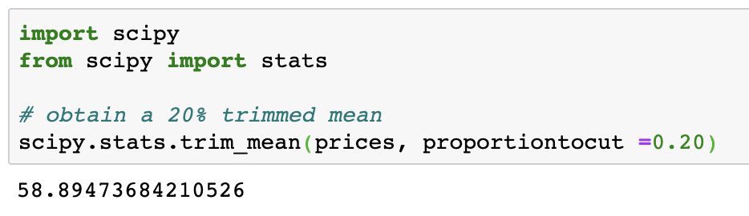
Obtain the trimmed mean
While working in python, we can directly use the built in function, trim_mean(), available in the library scipy.
Import the required library
Parameter ‘proportiontocut’ denotes the α% values to exclude. It takes value between 0 to 0.51

Slide 46
Median
Median is the middle most observation in the data when it is arranged either in ascending or descending order of their values
It divides the data into two equal parts. Thus, it is a positional average
Median will be the middle term, if the number of observations is odd
Median will be average of middle two terms, if number of observations is even

Slide 47
Median
Merits:
It is not affected by extreme values
Demerits:
It is not based on all observations

Slide 48
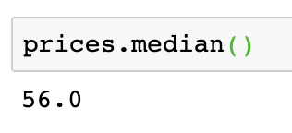
Obtain the median
Interpretation: The median value is 56. It implies that the value 56 divides the data in two equal parts. There are 50% of the observations above and below this price.

Slide 49
Using mean and median
For a numeric variable, the missing value is replace by the mean if there are no outliers present
In case if outliers are present the missing values are replaced by the median
For symmetric data median = mean, so either of the value can be used

Slide 50
Mode
Mode of the data is the value which has the highest frequency
In other words, it is most repeated observation
A set of observations having two modes is said to be bimodal
A set of observations may have more than two modes. Such data is said to be multimodal

Slide 51
Mode
Merits:
It is applicable to both numeric and categorical data
It is not affected by extreme observations
Demerits:
It is not based on all observations

Slide 52
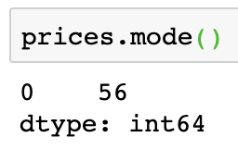
Obtain the mode
Notice that the output is a Series
56 is the mode value
0 is the index
Interpretation: The mode value is 56. It implies that the value 56 occurs the most number of times
Also note that there is only one mode. The data is unimodal

Slide 53
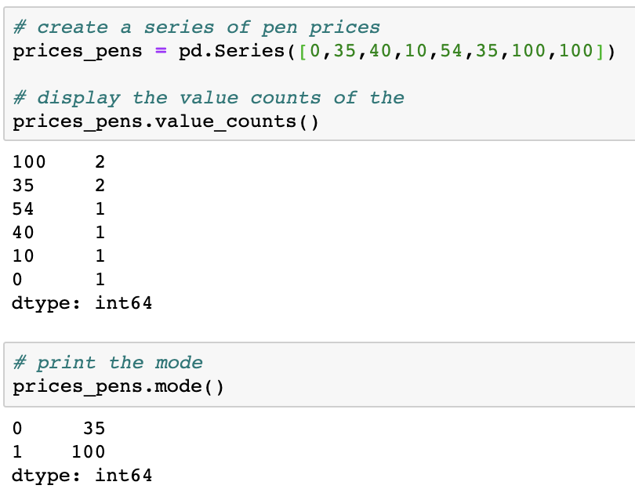
Obtain the mode
Interpretation: The mode values are 35 and 100. It implies that these values occur equal number of times and have the highest frequency.
Since there are two modes, the data is bimodal.
Number of times each value is appearing in the data
Notice values 35 and 100 each occur 2 times
The mode values

Slide 54
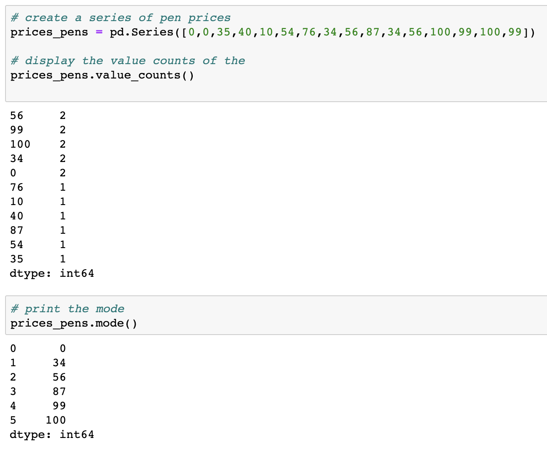
Obtain the mode
Interpretation: The mode values are 0, 34, 56, 87, 99, 100. It implies that these values occur equal number of times and have the highest frequency.
Also note that there are 6 mode values. Data is multimodal.
Number of times each value is appearing in the data
Notice values 0, 34, 56, 99, 100 each occur 2 times
The mode values

Slide 55
Partition values
Partition values are the values which divide the dataset into equal parts
Note that partition values may not be equispaced
Also known as quantiles
We have seen that the median divides the data into two equal halves. Similarly in order to make four parts we use quartiles, for ten parts we use deciles

Slide 56
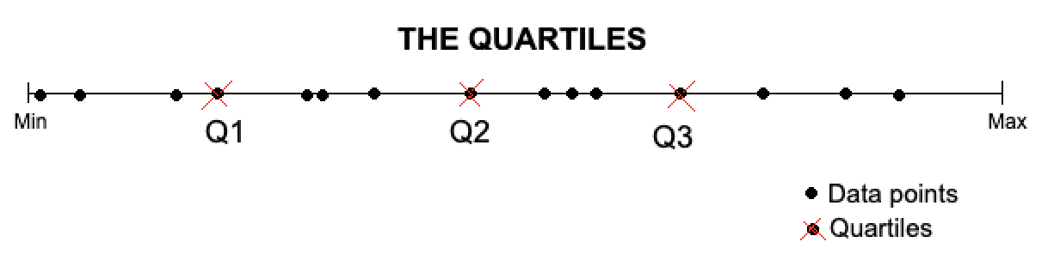
Quartiles
The values that divide the dataset into four equal parts are called quartiles
25% of the data lies below the first quartile (Q1) and 75% above it
The second quartile divides the data points in two equal halves. Q2 is the median
The third quartile (Q3) divides the the observation in 75%-25% meaning that 75% of the data lies below Q3 and 25% above it

Slide 57
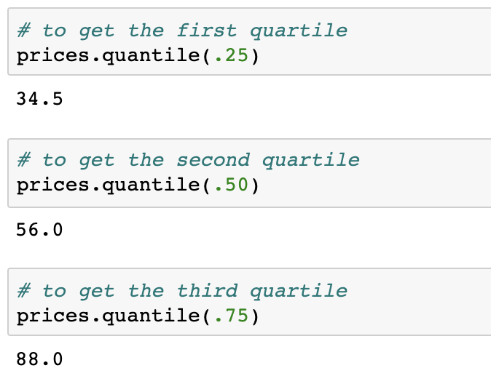
Obtaining the quartiles
The partition values are obtained using the quantile function specifying the percentage of data below the required partition value.

Slide 58
Deciles
The values that divide the dataset into ten equal parts are called deciles
10% of the data lies below the first decile (D1) and 90% above it
Similarly, 20% of the data lies below the second decile (D2) and 80% above it and so on
The fifth decile is the same as the second quartile i.e. D5 = Q2 = Median
There are in all 9 deciles

Slide 59
Obtain the nine deciles (D9) for the variable ‘prices’ defined before.
Similarly we define percentiles as values which divides the data into 100 equal parts. Obtain the 25th (P25), 50th (P50) and 75th (P75) percentile.

Slide 60
Summary
Mean, median and mode can be used to impute the missing values in the data
For a symmetric distribution, mean = median = mode
For any data,
Q2 = D5 = Median = P50
Mean is affected by the presence of outliers
Trimmed mean is useful when the outliers are present in the data
Median and mode are not affected by the presence of outliers

Slide 61
Distribution of the Data

Slide 62
Distribution of the data
The distribution is a summary of the frequency of values taken by a variable
The distribution of the data gives information on the shape and spread of the data
On plotting the histogram or a frequency curve for a variable, we actually look at how the data is distributed over its range

Slide 63
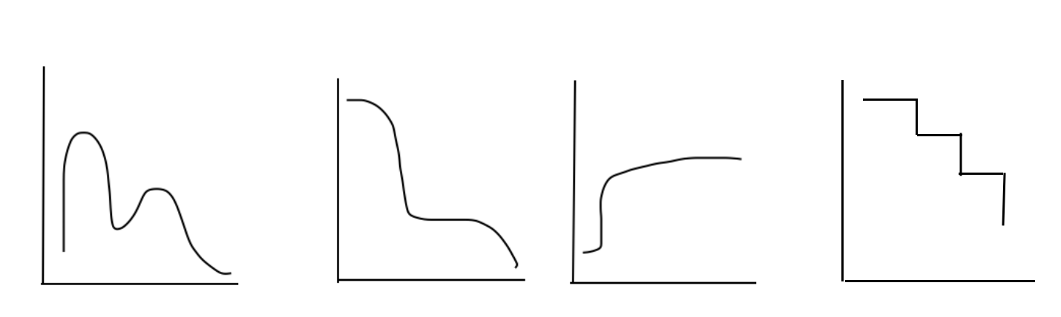
Distribution of the data
The data may be distributed in a random matter
However there are standard distributions in statistics like the normal distribution, binomial distribution, student’s-t distribution and so on
Some distributions

Slide 64
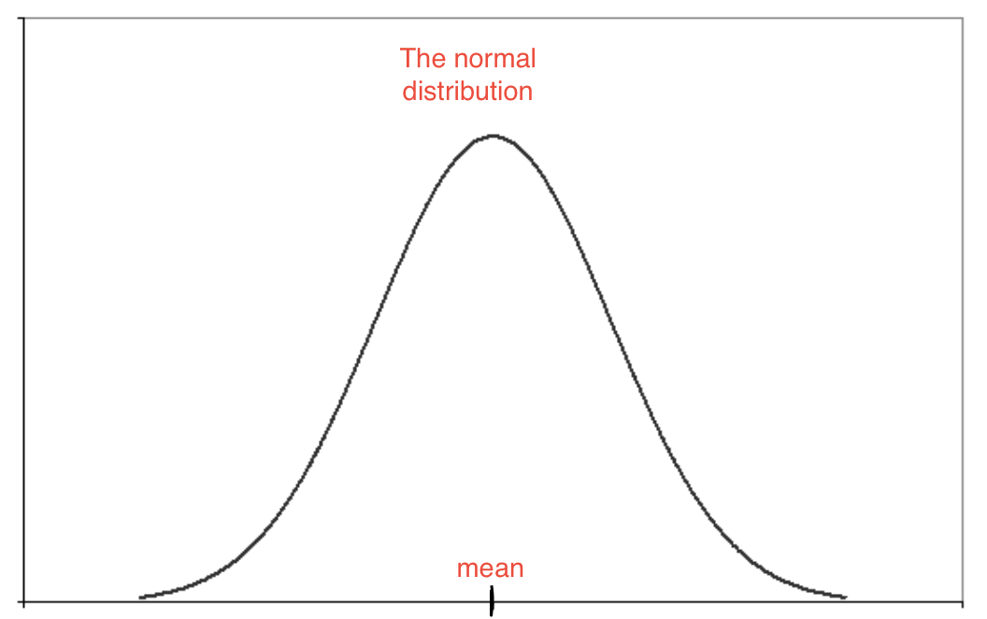
Normal distribution
It is the most important distribution
The distribution is bell shaped
Also called as the gaussian distribution
The frequent observations are found in the middle of the distribution, and further decrease away towards the tails

Slide 65
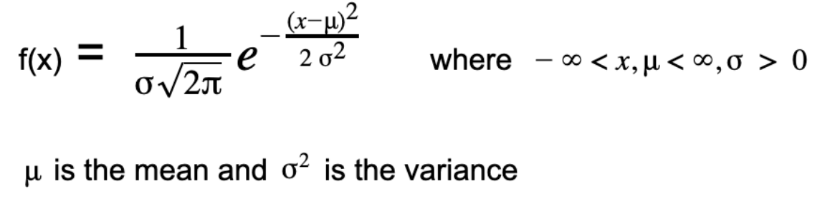
Normal distribution
It is given by the function:
x and μ take value between -∞ to +∞
Value taken by the variable X
σ is strictly positive
It is said that X ~ N(𝛍, σ²), i.e the variable X follows normal distribution with parameter 𝛍 and σ²

Slide 66
Characteristics of normal distribution
The distribution is symmetric about the mean
For a normal distribution mean = median = mode
The standard normal distribution has mean 0 and variance 1
For X ~ N(𝛍, σ²), Z = (x - 𝛍)/σ then Z ~ N(0, 1) that is the standard normal distribution

Slide 67
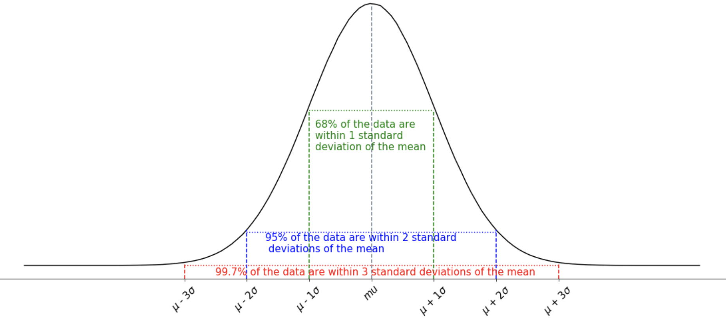
The normal distribution spread

Slide 68
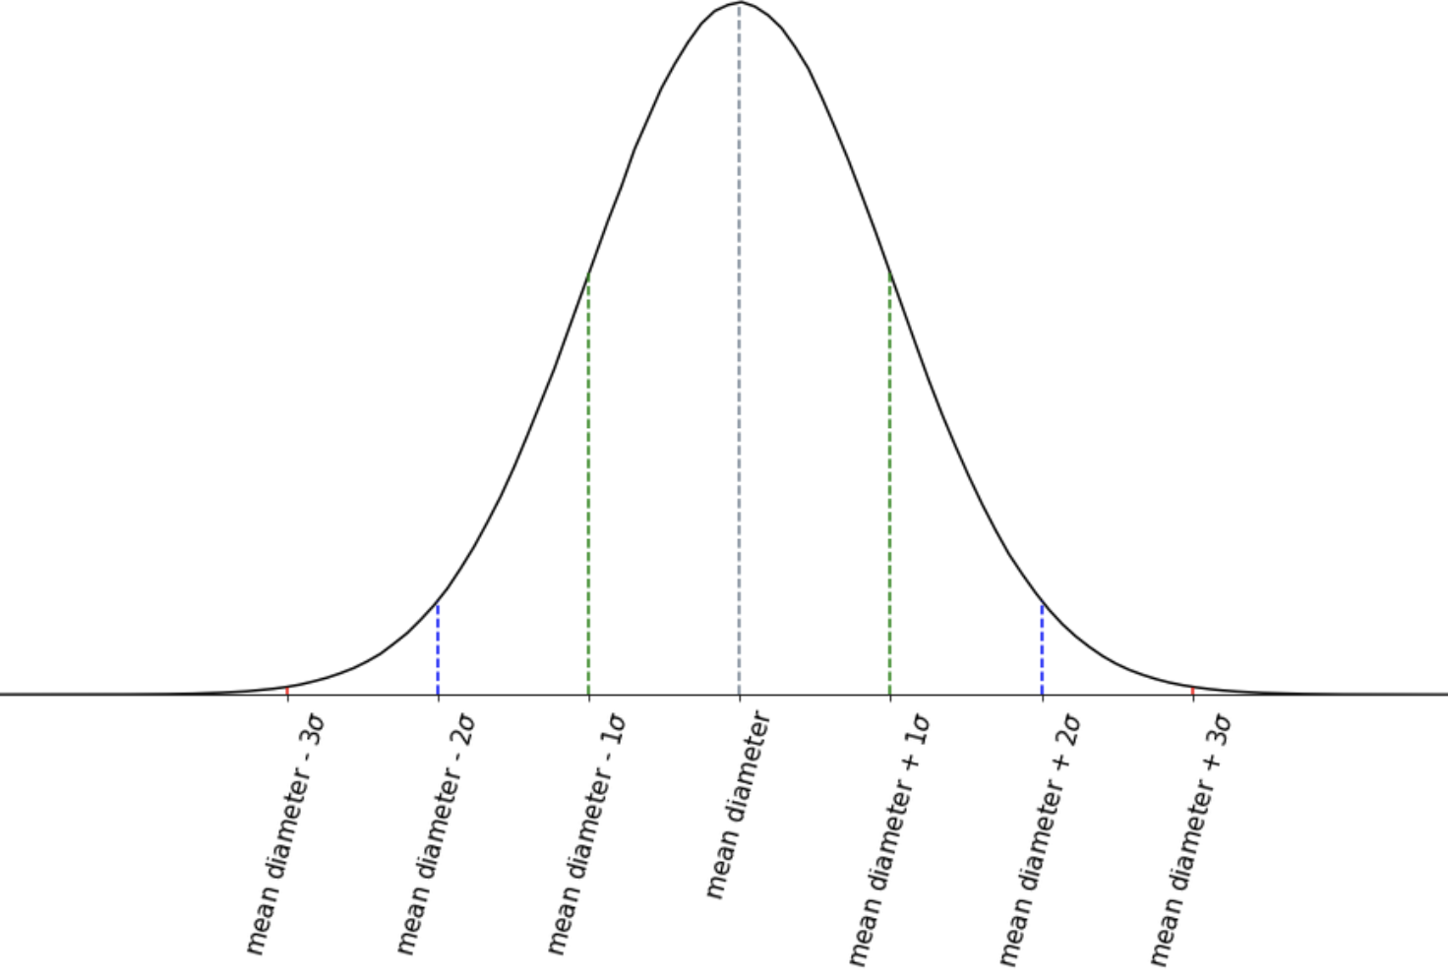
Normal distribution - example
Consider a manufacturer producing bolts. He records the diameter of bolts produced.
Most of the observations will be around the mean diameter. As we move away from the mean diameter the number of observations gradually reduce.

Slide 69
Summary
The distribution of the data gives information on the shape and spread of the data
The normal/gaussian distribution is bell shaped where mean = median = mode
The standard normal distribution has mean 0 and variance 1

Slide 70
Measures of Dispersion

Slide 71
Measures of Dispersion
The measure of dispersion refers to the variability within the data
Variability is the measure of how close or far the data lie from the central value
Reliability of a measure of central tendency is more if dispersion in the data is less
It includes range, variance, standard deviation, coefficient of variation and interquartile range

Slide 72
Range
Range is the difference between the largest and the smallest observation
It is defined as
Range = Xn - X1
where Xn is the largest value and X1 is the smallest value

Slide 73
Range
Merits:
It is a basic way to measure the variability
Demerits:
If either the smallest or the largest value turns out to be an outlier then the range value is unreliable
The other in-between observations do not affect the range value
It does not give a clear picture of variability in the data

Slide 74
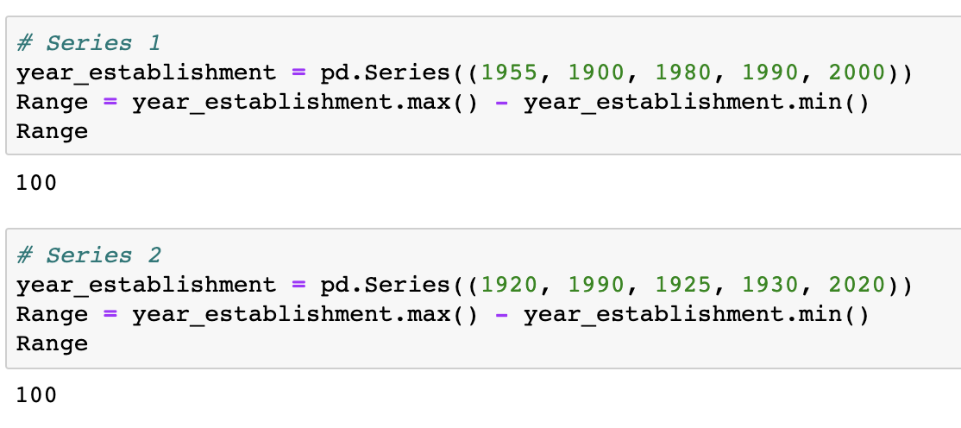
Obtain the range
Use the formula for range
Interpretation: The range of both the variables is 100. However, it seen that the first series has observations towards the maximum and the second series has observations towards the minimum.
Thus, range is not a good measure of dispersion.

Slide 75
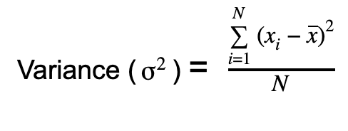
Variance
Variance is the arithmetic mean of squares of deviations taken from the mean. It is given as
Interpretation: The variance looks at how spread out the observations are from the mean. The higher the variance more the data is spread out.

Slide 76
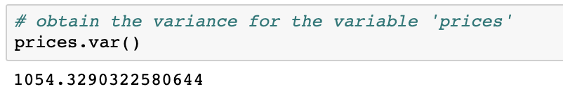
Obtain the variance
More the data is spread out away from the mean, higher the variance.

Slide 77
The unit of measurement of variance
The unit of measurement of the variance is not the same as that of the original data
Consider an industry producing screws. The diameter of each screw is noted in millimeters
The variance in the diameter is measured in squared millimeters
Thus a usual practice is to take square root of the variance which would have the same unit as the original data
The value thus obtained is called the standard deviation of the data

Slide 78
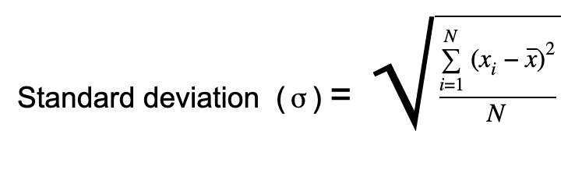
Standard deviation
The standard deviation of the variable is the square root of the variance.

Slide 79
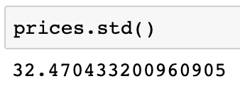
Obtain the standard deviation
Interpretation: The standard deviation looks at how spread out the observations are from the mean. The higher the standard deviation more the data is spread out.

Slide 80
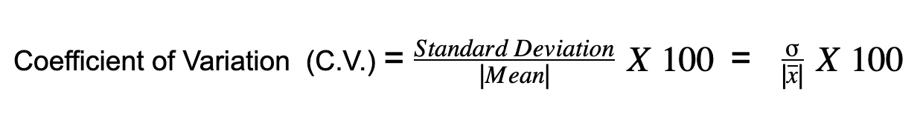
Coefficient of variation
The coefficient of variation is a statistical measure of dispersion of data points around the mean
It is always expressed in percentage and is unit free
Generally, used to compare dispersion of two or more groups
According to Karl Pearson, C.V. is the percentage variation in the mean and S.D. is the total variation in mean

Slide 81
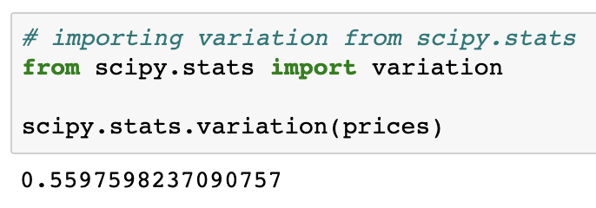
Obtain the coefficient of variation
The variation() from the scipy library computes the coefficient of variation.
Note: The name of the function can be quite misleading; do not confuse with ‘variance’.

Slide 82
Obtain the coefficient of variation
Consider two financial portfolios, A and B. Obtain the the better portfolio in which an investor should invest.
Portfolio | Expected Return (%) | Volatility (%)
A | 25 | 30
B | 10 | 15

Slide 83
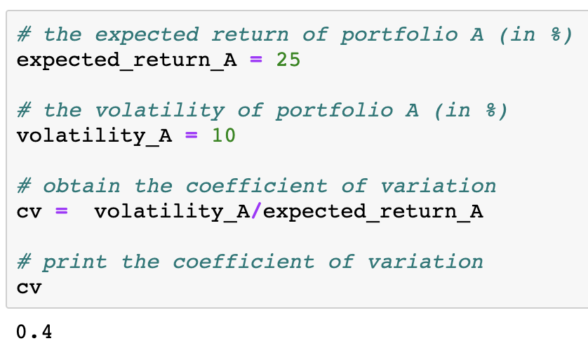
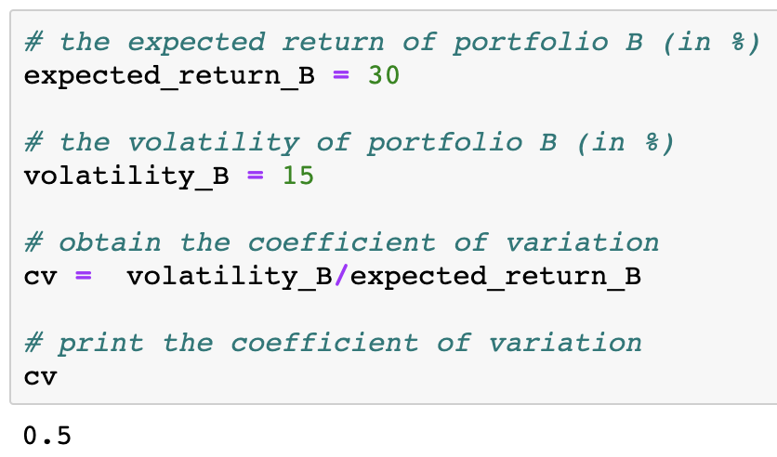
Obtain the coefficient of variation
Obtain the coefficient of variation for the two portfolios
Interpretation: The coefficient of variation for portfolio A is lower than that of portfolio B. So, the investor should invest in portfolio A because it is comparatively more consistent in its returns.

Slide 84
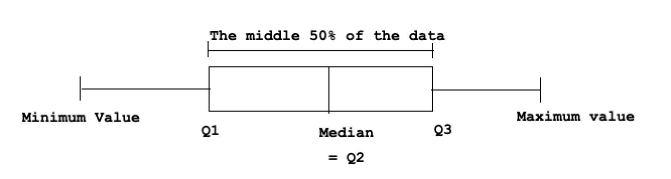
Quartiles
We have seen quartiles are kind of partition values
With the help of the quartiles we understand the spread of the data
Quartiles when plotted with box plot help in identifying the outliers

Slide 85
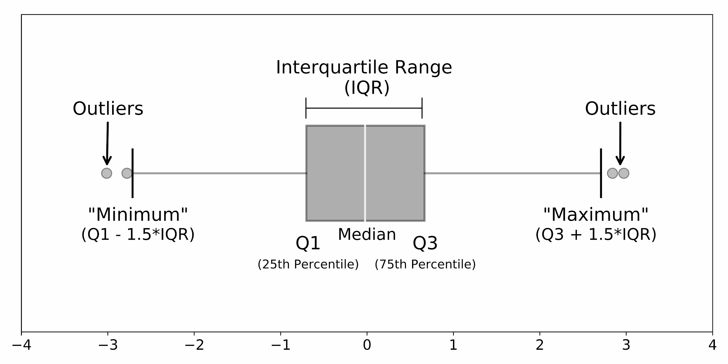
Understanding box plot
A box plot is a way of displaying the distribution of data based on a five number summary (minimum, first quartile (Q1), median, third quartile (Q3), and maximum)
The whiskers give an idea of the spread of the data
The dots outside of the whiskers are the outliers

Slide 86
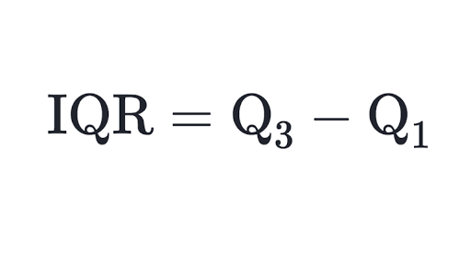
Interquartile range
The interquartile range is defined as the difference between the third and the the first quartile
It gives the range in which the middle 50% of the data lies
The value of IQR is used to remove outliers in the data

Slide 87
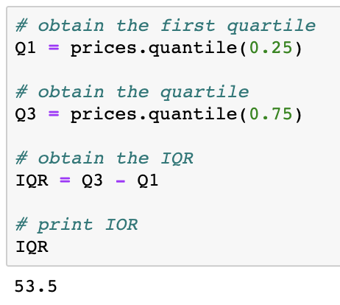
Obtain interquartile range
Interpretation: The interquartile range of the prices is 53.5

Slide 88
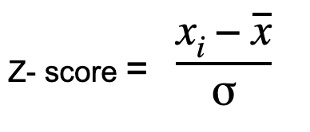
Z-score
Every value in the dataset has the z-score
To find the z-score of a value, subtract the mean from it and divide it by the standard deviation
The z-scores are extensively used in statistics especially in hypothesis testing
It is also used to normalize the data, ie is it scales the data to get the mean of the scaled data as 0 and variance as 1

Slide 89
Z-score
The z-score tells how much is the value away from the mean
Z-score Value | What it means?
0 | The corresponding value is same as the mean
< 0 | The corresponding value is less than the mean
> 0 | The corresponding value is greater than the mean
< -3 or > 3 | The corresponding value is potential outlier

Slide 90
Summary
Range is not a reliable measure as it do not consider the in-between observations
The variables with a near-zero standard deviation have less significance in the analysis
Coefficient of variation (CV) is the unitless quantity
Box-plot is used to visualize five-number summary (minimum, Q1, Q2, Q3, and maximum)
IQR can be used to detect and remove the outliers in the data

Slide 91
Skewness

Slide 92
Skewness
Skewness is a lack of symmetry or departure from symmetry
If the distribution of the data is elongated on either side then the data is said to be skewed
If the distribution of the data is elongated on the left side then the data is said to be left skewed
If the distribution of the data is elongated on the right side then the data is said to be right skewed

Slide 93
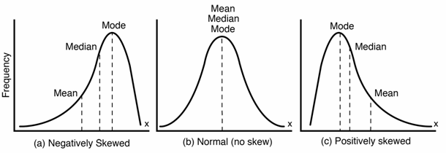
Skewness
The graph of skewed distribution
mean < median < mode
mean = median = mode
mean > median > mode

Slide 94
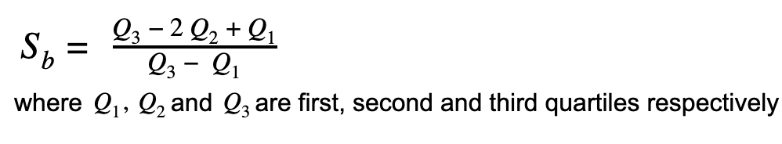
Calculate the skewness
The Bowley’s Coefficient of Skewness is defined as
Value of skewness | Interpretation
S_{b} < 0 | The distribution is negatively skewed
S_{b} = 0 | The distribution is not skewed (symmetric distribution)
S_{b} > 0 | The distribution is positively skewed

Slide 95
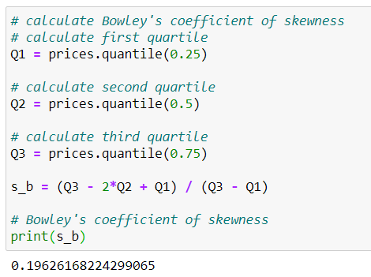
Calculate the skewness
The Bowley’s coefficient of skewness:
Interpretation: The coefficient is positive but near zero. Thus, the variable ‘prices’ is said to be near symmetric.

Slide 96
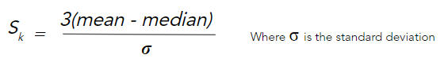
Calculate the skewness
The Karl Pearson’s Coefficient of Skewness is defined as
Value of skewness | Interpretation
S_{k} < 0 | The distribution is negatively skewed
S_{k} = 0 | The distribution is not skewed (symmetric distribution)
S_{k} > 0 | The distribution is positively skewed

Slide 97
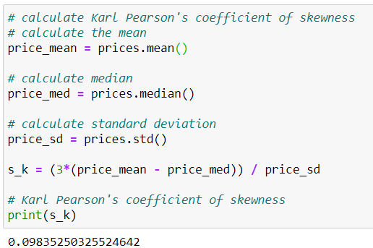
Calculate the skewness
The Karl Pearson’s coefficient of skewness:
Interpretation: The coefficient is positive but near zero. Thus, the variable ‘prices’ is said to be near symmetric.

Slide 98
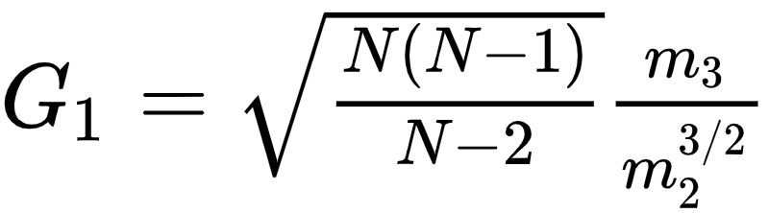
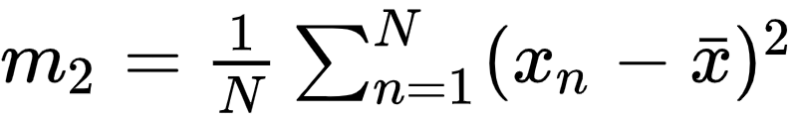

Calculate the skewness
The adjusted Fisher-Pearson Coefficient of Skewness is defined as
Where, m₂ and m₃ are the 2nd and 3rd central moments respectively.
and
This coefficient of skewness is based on the central moments of the distribution

Slide 99
Calculate the skewness
Value of skewness | Interpretation
G₁ < 0 | The distribution is negatively skewed
G₁ = 0 | The distribution is not skewed (symmetric distribution)
G₁ > 0 | The distribution is positively skewed

Slide 100

Obtain the skewness
In python, the ‘skew()’ returns the value of adjusted Fisher-Pearson coefficient of skewness.
Interpretation: The variable prices is slightly negative skewed. It can be said it is close to symmetric.

Slide 101
Coefficient of skewness
The magnitude of the coefficient of skewness explains the extent of skewness in the distribution
The +/- sign of a coefficient provides the direction of skewness
The coefficient compares the distribution of the sample to the normal distribution. Thus, the zero value represents the symmetric distribution
A higher magnitude of the coefficient indicates that the distribution highly differs from the normal distribution

Slide 102
Summary
Bowley’s Coefficient of Skewness
Karl Pearson’s Coefficient of Skewness
Fisher - Pearson Coefficient of Skewness
Based on quartiles
Value lies between -1 to +1
Can be used to calculate skewness for open-ended distribution
Preferred if the data has extreme values (outliers)
Based on mean, median and standard deviation
Usually value lies between -3 to +3
Can not be used for open-ended distribution, as we can not calculate the mean in such case
Based on central moments
Mostly used measure of skewness by different softwares
Can not be used for open-ended distribution, as we can not calculate the mean in such case

Slide 103
Kurtosis

Slide 104
Kurtosis
Kurtosis measures the peakedness of the distribution
In other words, it is a statistical measure that defines how the tails of the distribution differ from the normal distribution
Kurtosis identifies whether the tails of a given distribution contain extreme values
A histogram is an effective way to show both the skewness and kurtosis of a data set

Slide 105

Kurtosis
Value | Thickness of Tails | Interpretation
Kurtosis < 0 | Thin | The distribution is platykurtic
Kurtosis = 0 | Normal | The distribution is mesokurtic
Kurtosis > 0 | Thick | The distribution is leptokurtic

Slide 106

Obtain the kurtosis
We use kurt() to find the kurtosis
Interpretation: The variable ‘prices’ is platykurtic since -1.036 < 0. This means there are more dispersed prices with lighter tails. i.e. less extreme values.

Slide 107
Summary
A mesokurtic distribution is basically a normal distribution
A leptokurtic distribution has heavy tails on both the sides that indicates the presence of large outliers. Also the distribution is concentrated towards the mean than the normal distribution
A platykurtic distribution has flat/lighter tails on both the sides and it indicates that there are small amount of outliers in the distributions. Also, the values are more dispersed and fewer values are close to the mean

Slide 108
Covariance

Slide 109
Covariance
Covariance is a measure of how much two random variables vary together
Covariance is similar to variance, but variance explains how a single variable varies, and covariance explains how two variables vary together
It cannot tell whether the value indicates a strong relationship or weak relationship, since the covariance can take any value

Slide 110


Covariance
The covariance for two variables X and Y are given by

Slide 111

Obtain the covariance
Interpretation: There is a positive covariance between imports of raw material and export of finished goods

Slide 112
Correlation

Slide 113

Correlation
Correlation is the extent of linear relationship among numeric variables
It indicates the extent to which two variables increase or decrease in parallel
The value of a correlation coefficient ranges between -1 and 1

Slide 114

Correlation
A positive correlation exists if variable increase/decrease simultaneously
A negative correlation exists if one variable increases, while the other variable decreases

Slide 115

Obtain the correlation
Interpretation: There is a high positive correlation between imports of raw material and export of finished goods

Slide 116

Correlation
Correlation is normalized form of covariance
The two terms conceptually they are almost identical

Slide 117
Covariance and correlation
Covariance
tells whether two variables are related by measuring how the variables change in relation to each other
Gives the direction of the relationship
Correlation
Similar to covariance
Tells how strong is the relationship

Slide 118
Case Study

Slide 119
The mpg dataset
Let us now do a some practise on the dataset
We will work on mpg dataset
mpg stands for miles per gallon
The data is generally used to predict the miles per gallon of a car
Let us try and get some useful insights from the data

Slide 120

Import the dataset
Let us import the data and display its first 5 rows.

Slide 121

Check the size and variable type of the data
Interpretation: The dataset has 398 observation and 10 variables.
The variables performance, origin and name are categorical while others are numeric

Slide 122

Check for duplicates and the null values
Interpretation: The dataset has no duplicate rows.
However, variable horsepower has 6 missing values

Slide 123

Descriptive Statistics
The DataFrame.describe() gives the summary statistics of the numeric variables in the dataset
Interpretation: There are 6 missing values in the horsepower variable.
The vehicles under study have an average of 23.5 mpg with standard deviation of 7.8 mpg.

Slide 124

Descriptive Statistics
The DataFrame.describe(include = ‘object’ ) gives the summary statistics of the categorical variables in the dataset
Interpretation: From the counts of values, we understand that there are no missing values in the categorical variables.
The data has information on 305 models of cars, in which Ford Pinto occurs 6 times. Most of the cars have originated in the USA.

Slide 125

Skewness
We will now use the mpg dataset to obtain the skewness
Interpretation:The variables mpg, cylinders, displacement, horsepower and weight are positively skewed.
The variable acceleration has near symmetric distribution.
The variable model_year has symmetric distribution.
(Refer slide no. 98)

Slide 126

Kurtosis
Use kurt() to obtain the kurtosis.
Interpretation: The distribution of variables mpg, cylinders, displacement, weight and model_year is platykurtic. This implies that there are very less number of extreme observations in these variables.
The variables horsepower and acceleration are leptokurtic. This implies that the distribution of these variables is accumulated near mean, with the presence of more extreme observations.
(Refer slide no. 104)

Slide 127

Covariance

Slide 128

Covariance
Interpretation: We see there are variable having negative covariance with mpg, except for variables acceleration and model_year have positive correlation.

Slide 129

Correlation

Slide 130

Correlation
Interpretation: We see there are variable having high negative correlation with mpg, except for variables acceleration and model_year have positive correlation.

Slide 131
What does the diagonal of the covariance matrix give?

Slide 132
Question:
What does the diagonal of the covariance matrix give?
Answer:
Covariance is a measure of how much two random variables vary together. The diagonal of the covariance matrix gives the covariance of a variable with itself, that is, it gives the variance of that variable

